Slide 1

ACROSS CULTURES
STORY TIME

Slide 2
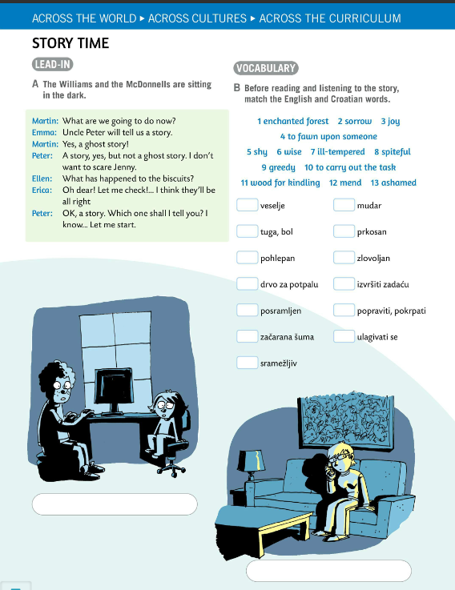
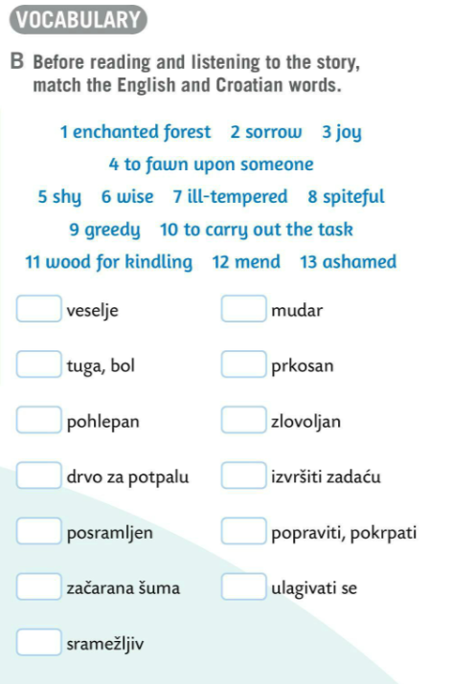
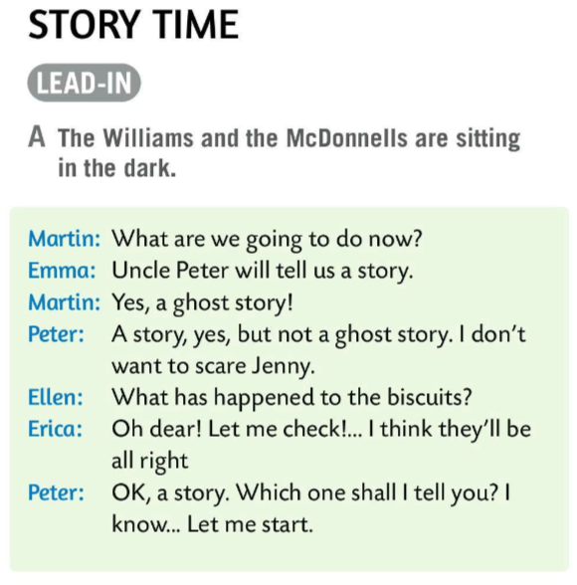


Read the text in Task A.
The Williams and the McDonnells are sitting in the dark.
What are they talking about?
Read and find out.
Match the English and the Croatian words.
Check.
Write the words and their translations.

Slide 3
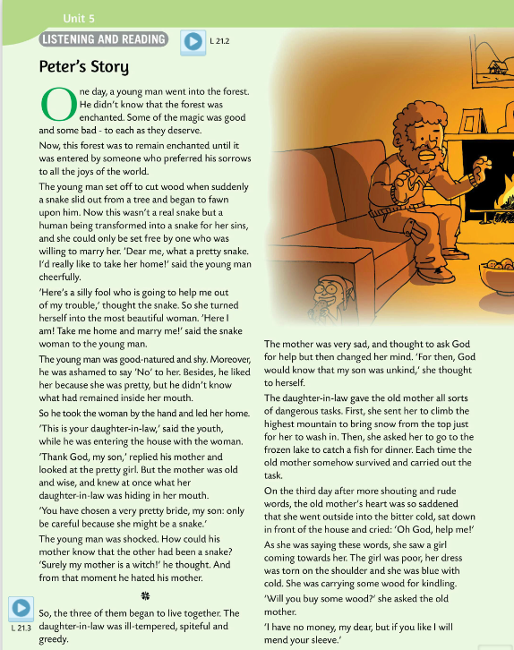

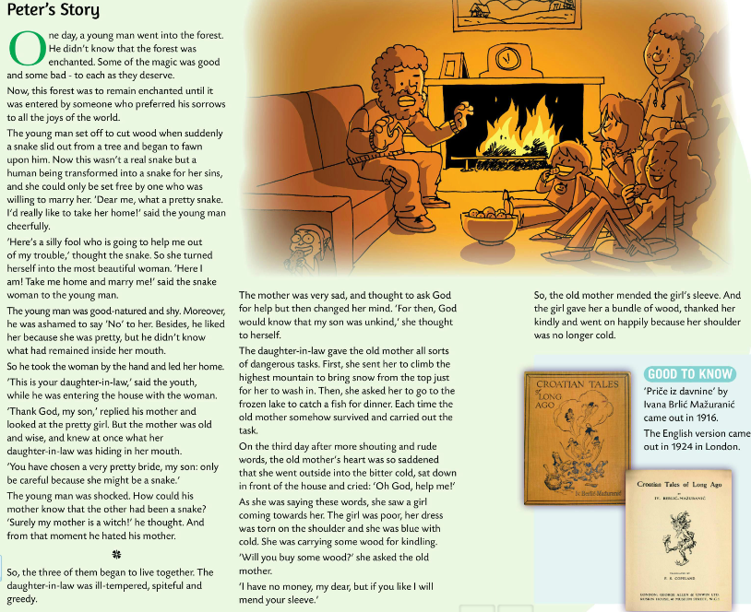
Listen to Peter’s story.
Read the story.
Did you recognise the story? Where does it come from? Who wrote it?
This story is called Stribor’s Forest and it comes from the book called Croatian Tales of Long Ago by Ivana Brlić-Mažuranić.

Slide 4
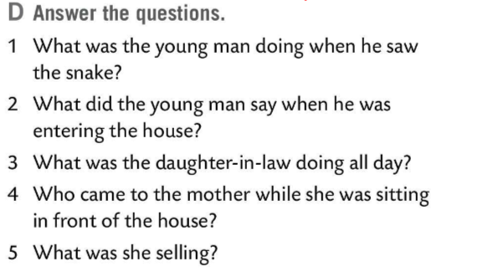
Answer the questions in Task D.
Check.
1 The young man was cutting wood when he saw a snake.
2 When he was entering the house, he said: ‘This is your daughter-in-law.’
3 The daughter-in-law was lazing around. She was giving the old mother all sorts of dangerous tasks.
4 While the old mother was sitting in front of the house, a girl in a torn dress came.
5 She was selling some wood for kindling.

Slide 5
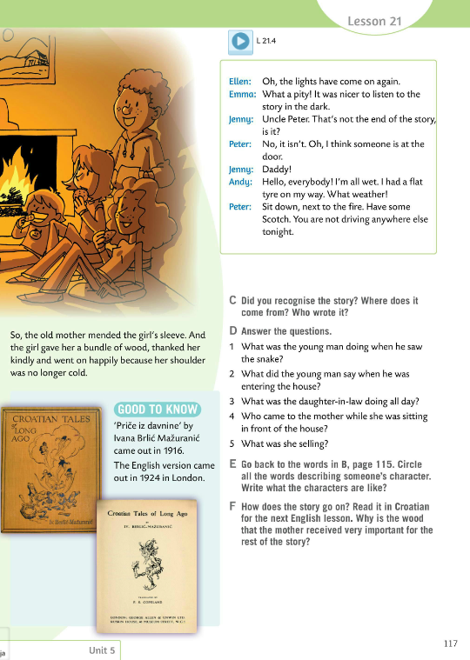
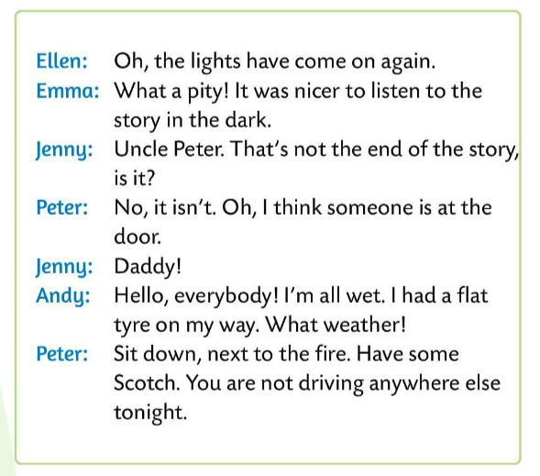
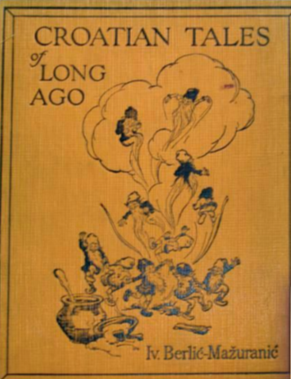
Listen to the recording and then read the dialogues in pairs.
Go back to Task B, page 115.
Circle all the words describing someone’s character.
What are the characters like?
Write their descriptions.
How does the story end?
Find and read it in Croatian
Why is the wood that the mother received very important for the rest of the story?

